Slide 1
NetSim VANETs
Detecting sybil node attacks in VANETs using Machine Learning
Applicable Release: NetSim v14.3 or higher
Applicable Version(s): NetSim Standard
Project download link: https://github.com/NetSim-TETCOS/Detecting-sybilnode-attacks-in- VANETs/archive/refs/heads/main.zip
The URL has the exported NetSim scenario for the examples used in this document and the python scripts to run classifiers.

Slide 2
Outline
Introduction to VANETs
Sybil attack in VANETs
Modeling Sybil attack in VANETs using NetSim
Attack Scenarios with sybil nodes – Training data
Attack scenarios with 1,1, 1, 2, 3, 3 sybil nodes
Data processing
Feature visualization
Attack Scenarios with sybil nodes – Test
Attack scenarios with 1, 1, 1, 3, 3, 3 sybil nodes
Data processing
Feature visualization
Classification
Detection of sybil nodes using ML based classifiers
Confusion Matrix: Accuracy, Precision, F1 Score, Recall
Comparison between different classifiers: Random Forest, K-Nearest Neighbor, Decision Tree, Gradient boost.
2

Slide 3
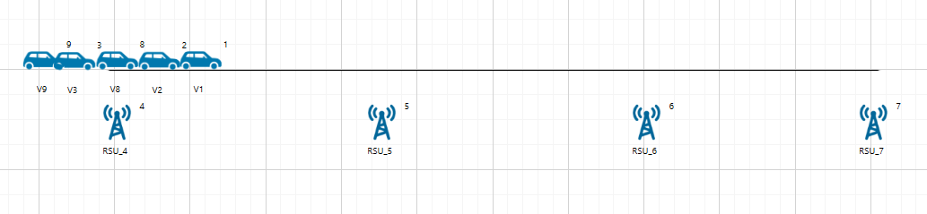
Introduction to VANETs
VANETs (Vehicular Ad Hoc Networks) are crucial for Intelligent Transportation Systems (ITS) and
road safety.
Vehicles communicate with each other (V2V) and with infrastructure (V2I).
VANETs operate in dynamic environments, with changing topologies due to vehicle speed and varying road conditions.
The communication architecture follows the IEEE 802.11p standard for PHY and MAC layers and the IEEE 1609 standard for upper layers, enabling Wireless Access in Vehicular Environments (WAVE).
A vehicular ad hoc network with 5 vehicles and 4 road-side units (RSUs)
3

Slide 4
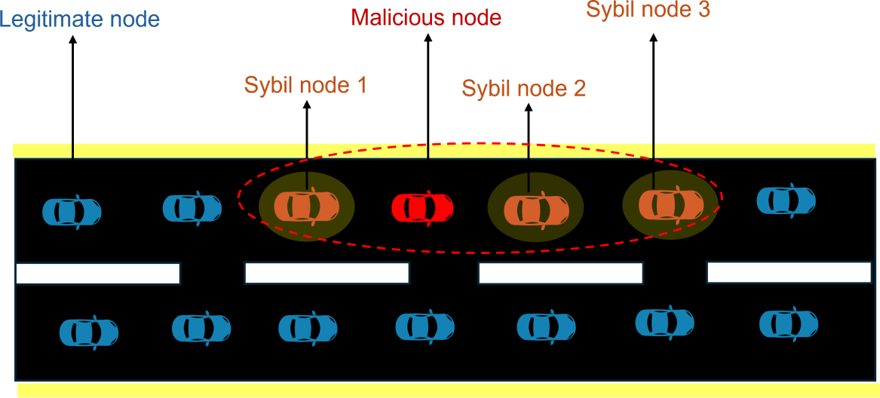
Sybil attack in VANETs
Definition: A Sybil attack in VANETs occurs when a malicious vehicle creates multiple fake identities or "ghost vehicles" in the network.
Mechanism: The attacker broadcasts messages from these fake identities, making it appear as if multiple vehicles are present when in reality, it's just one malicious node.
Purpose: These attacks aim to manipulate traffic data, influence routing decisions, or gain an unfair advantage in safety-critical applications.
Impact: Sybil attacks can lead to false traffic congestion reports, manipulated voting systems in VANETs, and compromised safety applications, potentially causing accidents or traffic disruptions.
Sybil attack scenario in VANETs
Detection: RSSI values are used to estimate the
physical location of nodes in the network. In a Sybil
attack, multiple fake identities originating from the same physical location should have very similar RSSI values when measured by receiving nodes. By analyzing the similarity of RSSI patterns malicious nodes can be detected
4

Slide 5
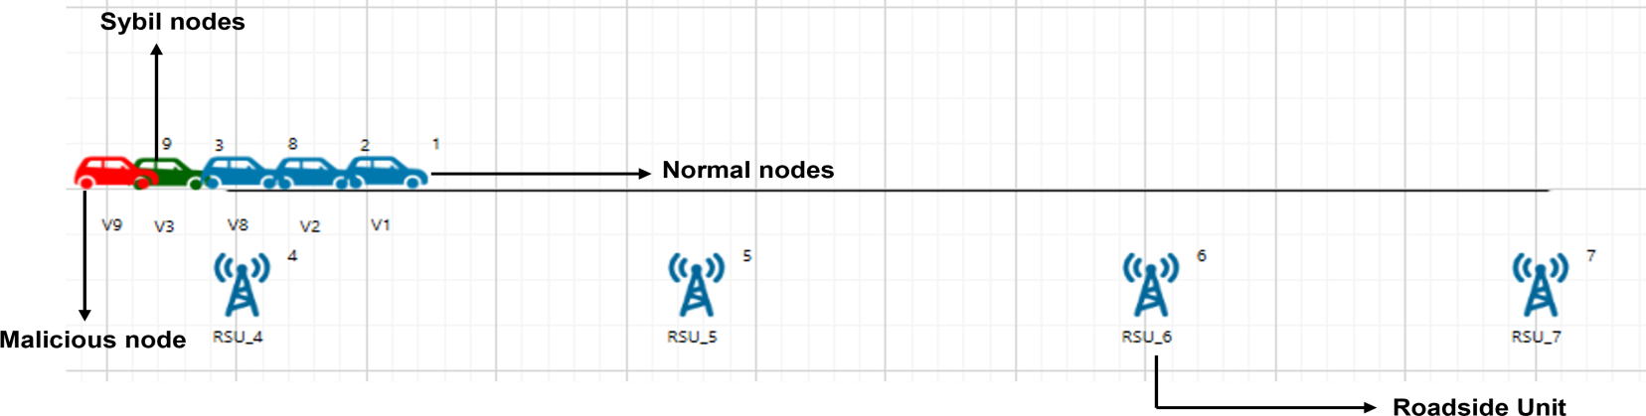
Sybil attack in VANETs using NetSim
A Sybil attack in NetSim involves a malicious node (sybil attacker) creating illusory nodes, known as a Sybil nodes.
The malicious node transmits messages as if it were two separate entities, misleading the network into
believing there are two independent participants.
To model this in NetSim, we create two nodes: V3 (the malicious node) and V9 (the Sybil node), where both nodes behave as if they are distinct entities.
The scenario has 5 vehicles (3 real + 1 attacker + 1 sybil node) and 4 RSUs, each vehicle transmits data to all RSUs.
Since the signal strength from the sybil attacker and the sybil node would be similar, RSSI-based
classification can be used to detect malicious nodes
The network topology in VANETs includes 1 malicious node (sybil attacker in red) and 1 illusion (sybil node in orange) and 3 normal vehicular (in blue)
5

Slide 6
Training
6

Slide 7
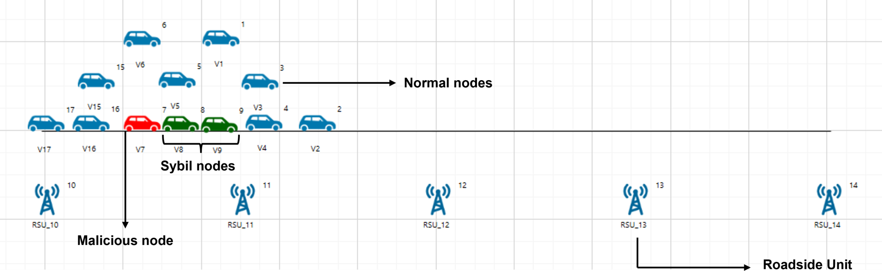
Attack scenarios – Training data generation
In NetSim, we created 5 scenarios with varying total node counts (5, 7, 9, 11, 12 to
13).
Total Node count = Normal node count +
Sybil attacker count + Sybil node count
Sybil node count in the 6 scenarios: 1, 1, 1, 2,
3, 3.
1 malicious node in all cases
1, 1, 1, 2, 3, 3 sybil nodes in each
respective sample
In NetSim, we enabled radio measurement log for all scenarios
We wrote a python script to analyze the log file data and calculate the RSSI Power at each RSU from each vehicle, RSSI difference and RSSI Similarity
The network topology in VANETs includes 1 malicious node (sybil attacker in red) and 2 illusion (sybil node in green) and 3 normal vehicular (in blue)
Feature Extraction: RSSI Power, RSSI Difference, RSSI Similarity
Yuan Yao et al., “Power Control Identification: A Novel Sybil Attack Detection Scheme in VANETs using RSSI,” 2019, IEEE.
7

Slide 8
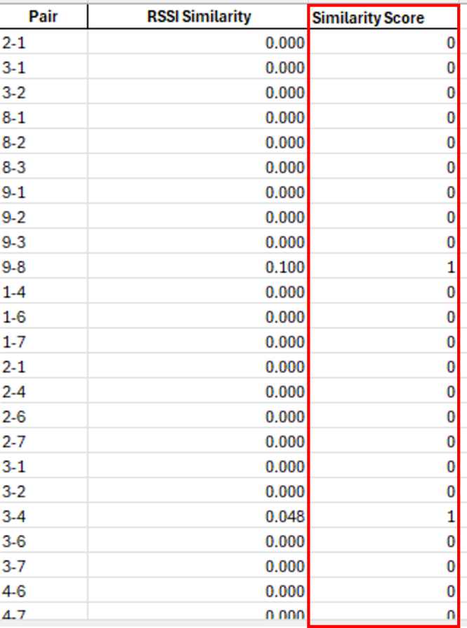
Data processing and feature visualization
Data extraction from IEEE radio measurement log to Excel using Python script
Total dataset: 57 vehicles, 3 features each
Feature normalization process:
Calculate the pairwise RSSI differences between vehicles for each RSU.
Compute the mean RSSI difference for each vehicle pair.
Assign a threshold to classify vehicle pairs based on RSSI differences.
Threshold values in our case are 0.1, 0.09, 0.03 & 0.02.
Identify similar vehicle pairs based on the threshold.
Calculate the proportion of similar pairs from the total vehicle pairs.
Identify each unique vehicle pair.
Calculate the average RSSI similarity for each unique pair.
Label the similarity score as 0 or 1, depending on the
RSSI similarity value.
We label the similarity score based on features

Slide 9
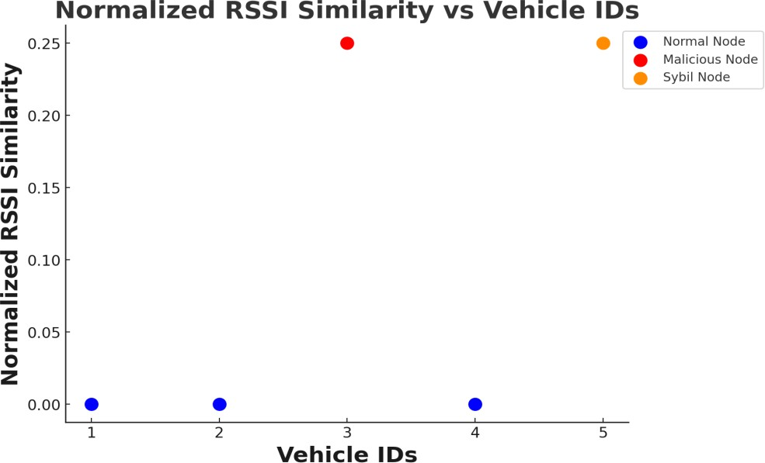
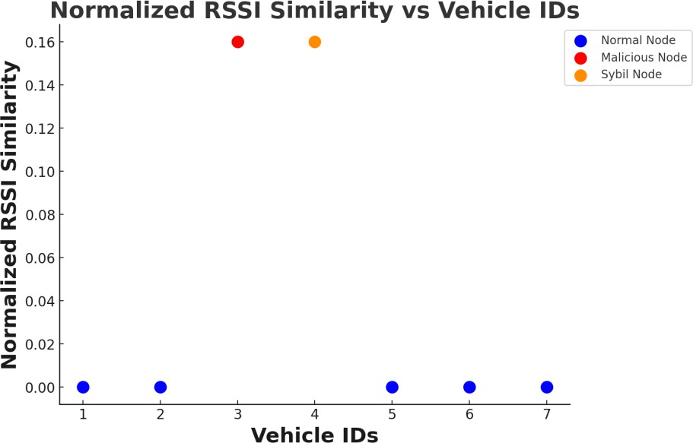
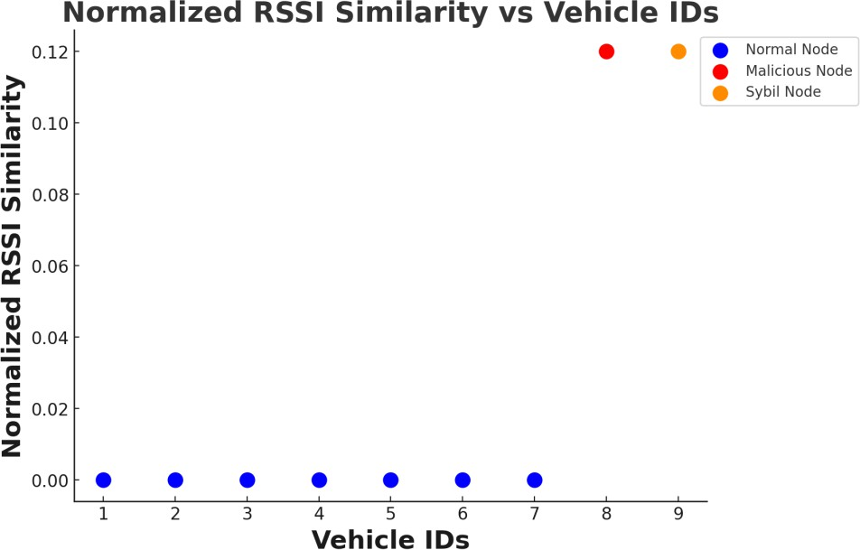
Feature visualization: 5 ,7 and 9 vehicles

Slide 10
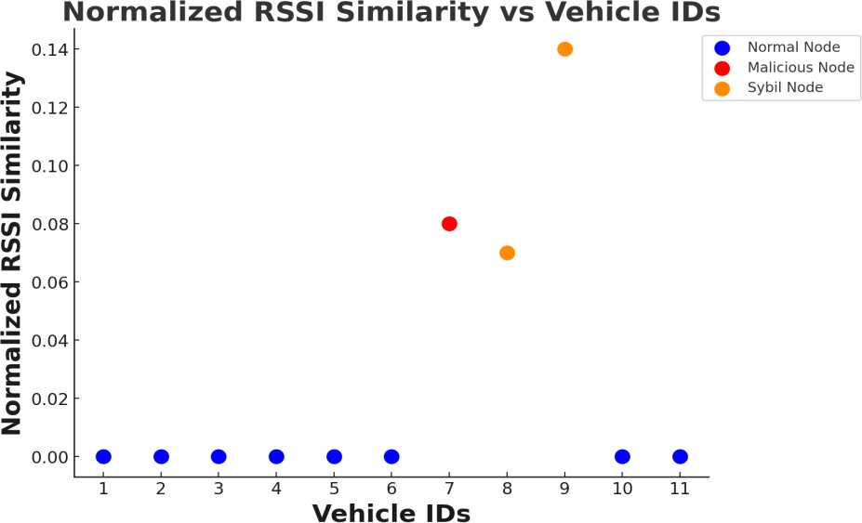
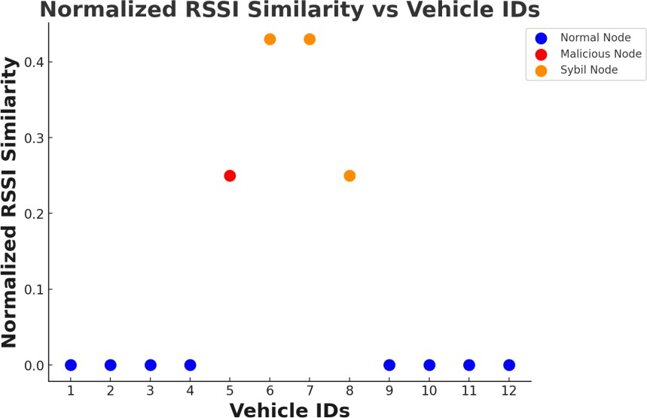
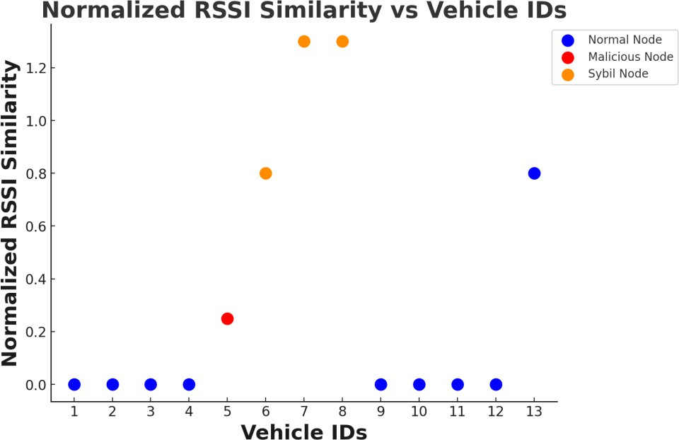
Feature visualization:11,12 and 13 vehicles

Slide 11
Classifier training
Features data was used to train the following classifiers:
K-Nearest Neighbor
Random Forest
XGBoost Classifier
Decision Tree

Slide 12
Inference

Slide 13
Inference and Test Scenarios
Created 6 new scenarios with different node counts (5, 6, 9,12,12, 14).
Sybil node count: 1, 1, 1, 3, 3, 3.
Normalized the data using a python script as explained in slide 8.
The network topology in VANETs includes 1 malicious node (sybil attacker in red) and 2 illusion (sybil node in orange) and 3 normal vehicular (in blue)

Slide 14
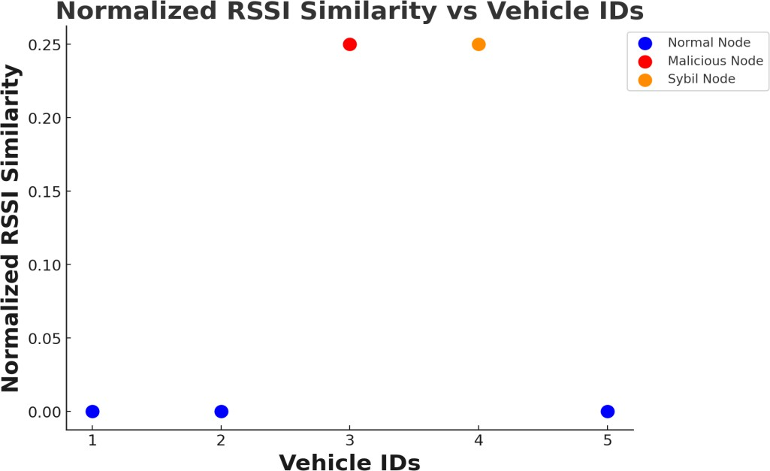
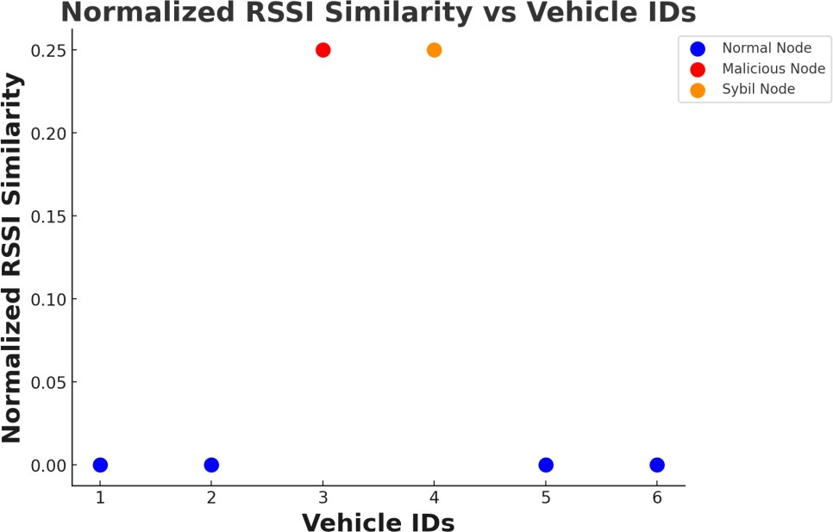
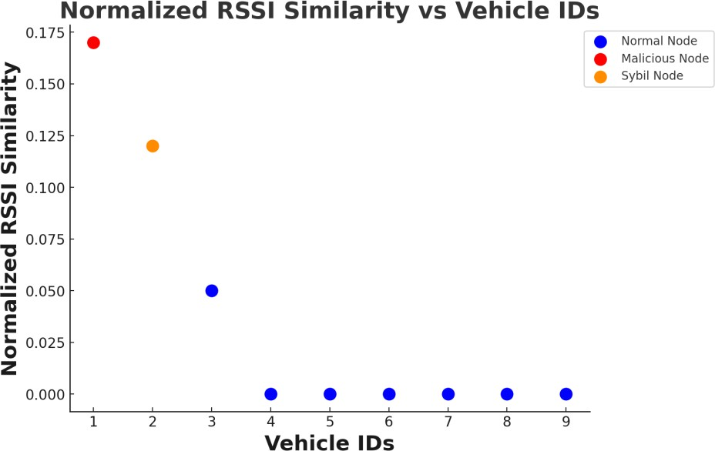
Feature visualization: 5, 6 and 9 vehicles

Slide 15
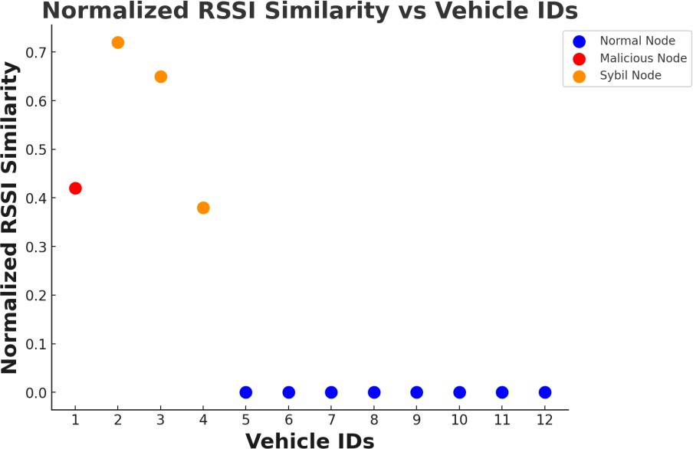
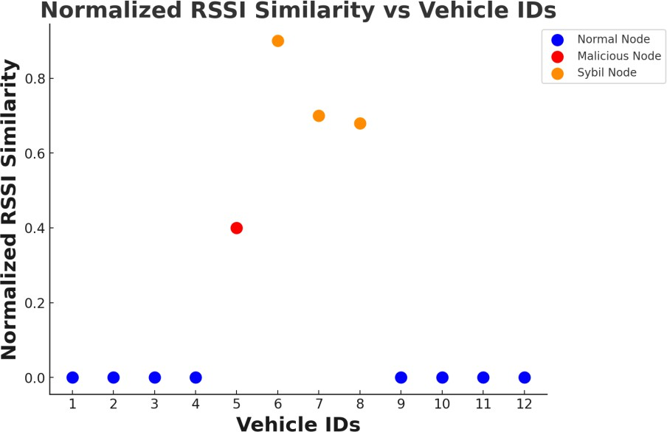
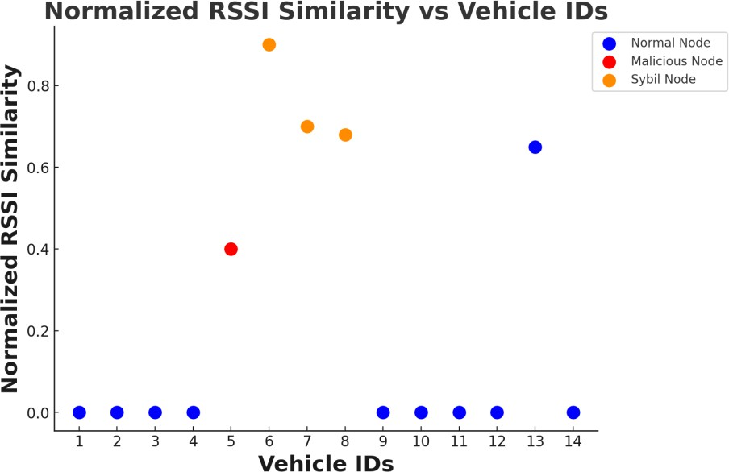
Feature visualization: 12, 12 and 14 vehicles

Slide 16
Confusion matrix
Confusion matrix summarizes the performance of a machine learning model on a set of test data.
Displays the number of accurate and inaccurate instances based on the model’s predictions.
Used to measure the performance of classification models
Confusion matrix components:
True Positive (TP): Predicted as positive, and it actually is positive.
True Negative (TN): Predicted as negative, and it actually is negative.
False Positive (FP): Predicted as positive, but it is actually negative.
False Negative (FN): Predicted as negative, but it is actually positive
Performance metrics:
Accuracy: The overall correct predictions (TP + TN) divided by the total number of instances.
Precision: The number of true positives divided by the total number of predicted positives (TP + FP).
Recall: The number of true positives divided by the total number of actual positives (TP + FN).
F1 Score: The harmonic mean of precision and recall, providing a balance between the two.

Slide 17
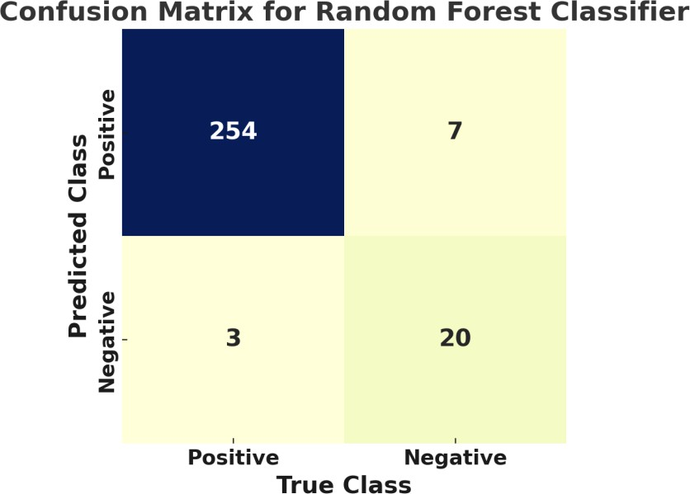
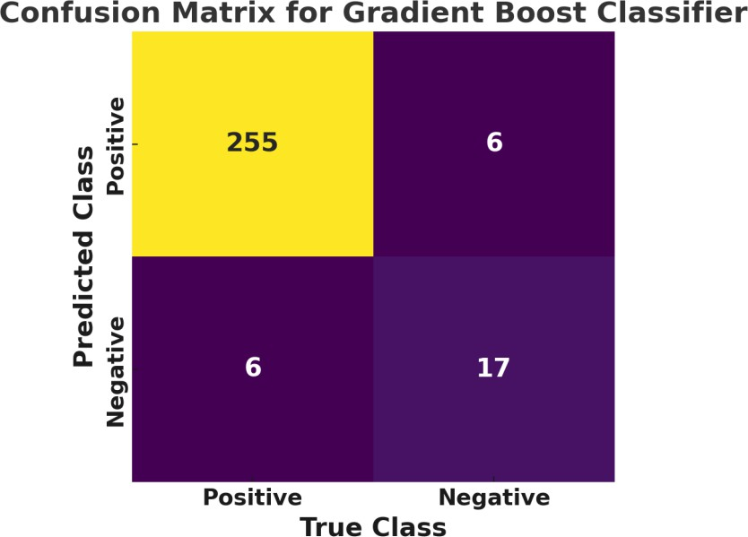
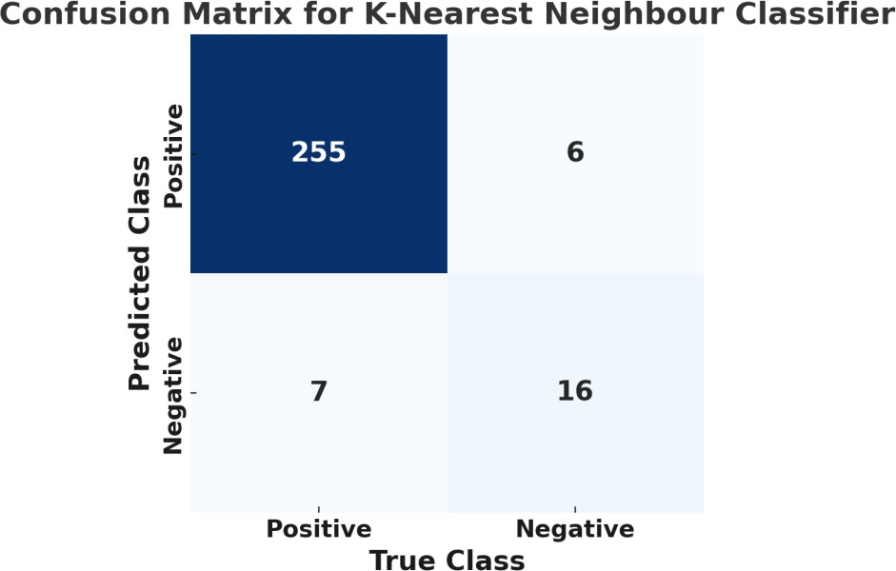
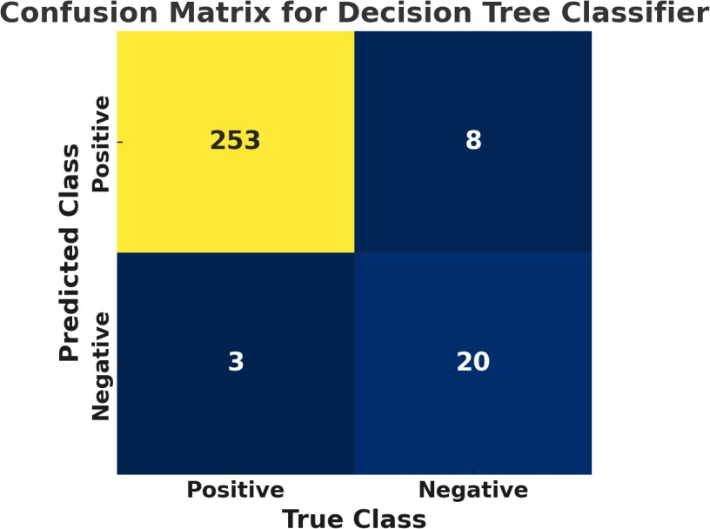
Confusion Matrix: Accuracy, Precision, F1 Score, Recall

Slide 18
Comparison and future work
Classifier | True Positives | True Negatives | False Positives | False Negatives | Accuracy | Precision | Recall | F1 Score
Random Forest | 254 | 20 | 7 | 3 | 0.96 | 0.74 | 0.87 | 0.80
KNN | 255 | 16 | 6 | 7 | 0.95 | 0.73 | 0.70 | 0.71
xgBoost | 255 | 17 | 6 | 6 | 0.97 | 0.80 | 0.87 | 0.83
Decision Tree | 255 | 20 | 8 | 3 | 0.96 | 0.74 | 0.74 | 0.74
Key Observations
Accuracy: All classifiers perform well, with accuracy ranging from 95% to 97%.
Precision: Varies from 73% (KNN) to 80% (xgBoost),
Recall: Varies from 70% to 87% suggesting good but not perfect detection of Sybil nodes.
F1 Scores: Range from 0.71 to 0.83; a reasonable performance; xgBoost has the best score.
Future Work
Test with larger networks to assess scalability.
Experiment with ensemble methods to potentially improve overall performance.
Impact of different VANET scenarios (e.g., urban vs. highway) on classifier performance.
Explore ways to improve precision

Slide 19
Appendix: How-to-Guide

Slide 20
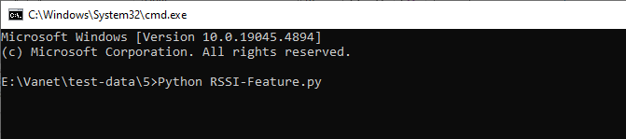
How to classify data?
To generate an excel file containing 3 feature messages for each vehicle, follow these steps,
Modify the file paths in the python script according your setup.
Open the command prompt.
Navigate the folder containing python script.
Run the “RSSI-Feature.py” script to process the radio measurement file and generate excel file for every individual case.
You can place the python script anywhere, as long as the file paths are correctly set to locate the necessary data files, including the test and training data scenarios that contain the radio measurement file.
After running the script, it will generate the RSSI-features.csv file in the folder contains radio measurement log.

Slide 21
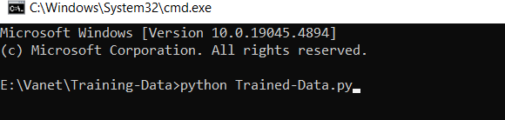
How to Normalize the data?
To generate an excel file containing the normalization of 3 feature messages of all the test and training scenarios, follow these steps:
Modify the file paths and input files required for merging the data into an Excel file in the Python
script according to your setup.
Open the command prompt.
Run Trained-Data.py separately to obtain all features in a new Excel file. Manually provide the similarity score.
Run Test-Data.py to extract all features into a single Excel file.

Slide 22
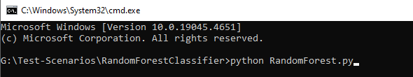
How to run the classifiers
Run each classifier against the trained data by providing the file locations for both the Merged Train-Data and Merged Test-data.
Modify the path in the python script of each classifier according to your setup.
Open the command prompt and run the script as shown below.
The Python script generates four sets of predicted labels and uses this data to create confusion matrices.

Slide 23
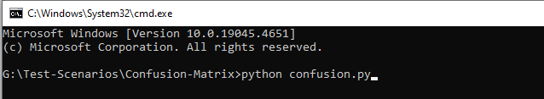
How to get the confusion matrix?
After obtaining the predicted labels from the classifiers,
Use these predicted label excel files along with the real test data i.e., sheet-2 of Merged test data.xlsx file to run the python script and generate the confusion matrix.
Place the real training data in the same folder to make it ease.
Modify the paths in the python script of Confusion-Matrix according to your setup.
Open the command prompt and run the script as shown below.
Each classifier's data generates a individual confusion matrix for that classifier.

